Slide 1
KX-NS Step by Step Guide
Activation Key
July 28, 2014
Panasonic System Networks
PBX SE team
Specifications are subject to change without notice.
Notes:
1

Slide 2
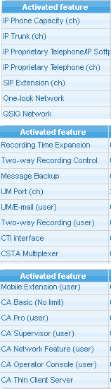
1. Activation Key List
As “Memory” to expand extension capacity to more than 30.
This AK is only for KX-NS1000.
As “CO card” & “Extension Card” (same as TDE/NCP)
Panasonic KX-UT phone is treated as Panasonic KX-NT IP-PT for activation key. (Not as SIP phone )
PBX to PBX one-look network for master and slave PBX
See (*1).
Recording time expansion : 2h to 15h
Automatic recording by supervisor
Message backup to USB memory or NAS
As “TVM204” : 2-ch based
(*2)
[2-way Record] button for PT or CA
To upgrade built-in UM to KX-TVM full features
Activation key is required for CTI server except CA and CSTA MUX.
(same purpose as TDE/NCP)
Enhance feature activation key for TDE/NCP is
divided to Mobile feature and Enhanced QSIG feature.
*1)
(same purpose as TDE/NCP)
(*2) Transfer Fax or VM using e-mail (server) /
Built-in IMAP feature / Send fax (fax driver)
Activation key for KX-TDE/NCP cannot be used for KX-NS PBX, even for same purpose.
Notes:
2

Slide 3
2. Conditions for One-look Network
- When virtual card is installed to slave PBX, these AK
are required to slave PBX for quantity of ch.
- Each maser and slave PBXs need each one AK.
- Only maser PBX needs one AK because TIE table is
programmed only in master PBX.
- When built-in VM(UM) of slave unit is used, these AK
are required to slave unit.
- Same as “Mobile Extension” and “CA”.
- Only maser PBX needs one AK because master PBX
communicates with CTI server.
- Only master PBX needs AK for quantity of “users in
master PBX” and “users in slave PBXs”.
- Only master PBX needs one AK.
Notes:
3

Slide 4
Chapter 1
Activation Key Installation

Slide 5
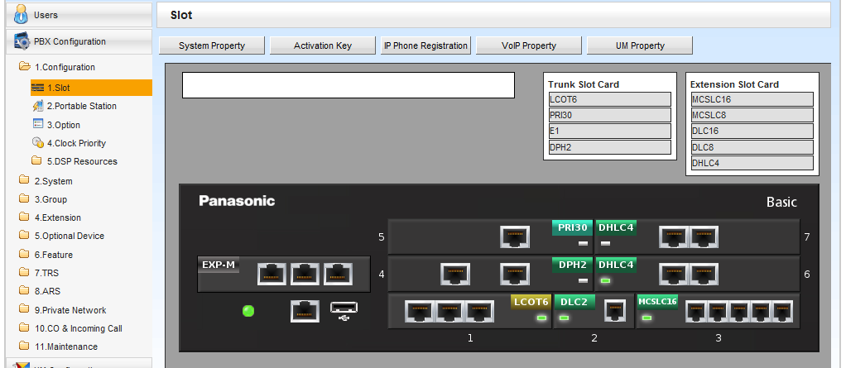
11. Window for Activation Key
Click “Activation Key”.
Notes:
5

Slide 6
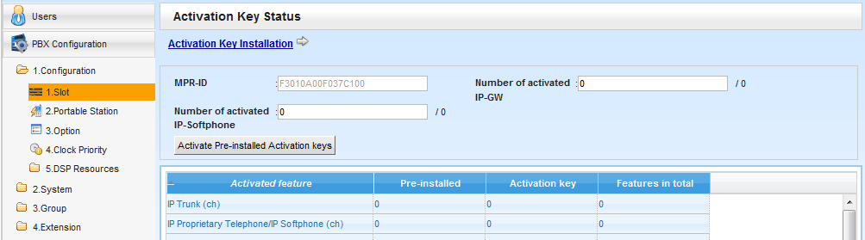
12. MPR ID
Confirm MPR-ID and get activation key file for the MPR-ID from Key Management System.
Notes:
6

Slide 7
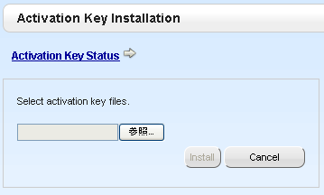
13. Activation Key File Installation
Install the activation key file.
Notes:
7

Slide 8
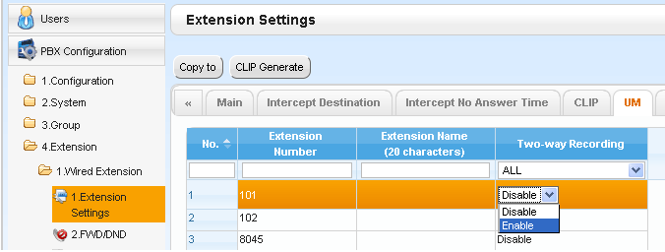
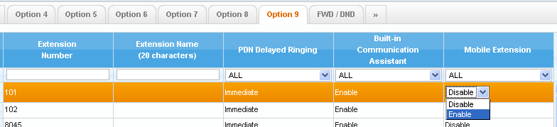
14. Quantity of User
These features have to be enabled for extension.
And activation key is required for quantity of user who
want to enable these features.
Mailbox based
(Not Ext based)
- Extension / Cellular phone parallel ring (Keep ring after Fwd No Answer)
- Virtual PS (Cellular) in ICD group
- Remote walking COS through DISA without PIN
- Automatic DISA connection for Fwd / Transfer to detect end of call for CO-CO
Notes:
8

Slide 9
Chapter 2
Temporary Activation Key
Notes:
9

Slide 10
21. Temporary Activation Key
Temporary AK has 3 types.
Expiration | 60-day | 180-day | 10-day
Built-in | Yes | No Download from KMS. KMS = Key Management System web
AK Type | Limited AK (See next page.) | Any AK | Any AK
PBX | KX-NS PBX only | KX-TDE/NCP/NS | KX-TDE/NCP/NS
Purpose | Trial If user likes the feature, sell regular AK. 60-day trial can start anytime for each feature. | Pay Later When dealer installs PBX hardware and inventory of AK is not enough, dealer can get this AK now and has to buy regular AK in 180-day. | Demo (and so on) When sales company or dealer wants to do demo, this AK is useful.
Remark | Trial is available only one-time for each one feature. | Download is available only one-time for one MPR card. | Download is available repeatedly. (8 times)
Notes:
.

Slide 11

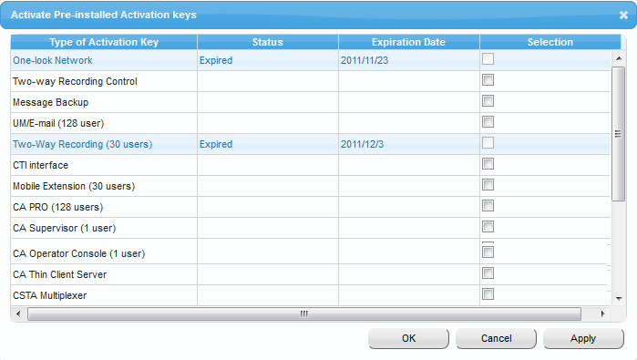
22. Built-in Temporary AK for Trial
Notes:
.

Slide 12
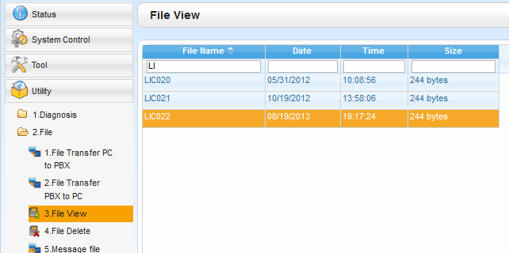
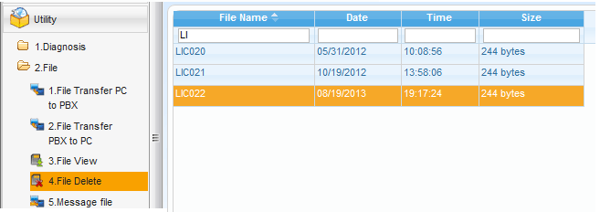

23. After Expire
When 10-day AK or 180-day temporal AK is expired, system restarts automatically at midnight.
You can view and delete temporal AK file manually before expiration.
Notes:
.

Slide 13
Thank you !
Notes:
13

Slide 14
Revision
Date | No. | Change
Sep 11 | - | First edition
Dec 14 | - | Picture was revised.
Mar 14 | 21 (Page 10) | 10-day activation key : 8 times
July 28 | 1 (Page 2) | KX-TVP full features => KX-TVM full features
Notes:
14

